Slide 1
CT techniques
Renal imaging
Dr. Rabab Yasin,MD
professor of radiology
Faculty of Medicine, Menoufia University

Slide 2
ANATOMY
-Kidneys:
A pair of bean-shaped organs approximately 12 cm long. They extend from vertebral level T12 to L3 when the body is in the erect position. The right kidney is positioned slightly lower than the left because of the mass of the liver.
Internal structure-
Within the dense, connective tissue of the renal capsule, the kidney substance is divided into an outer cortex and an inner medulla.

Slide 3
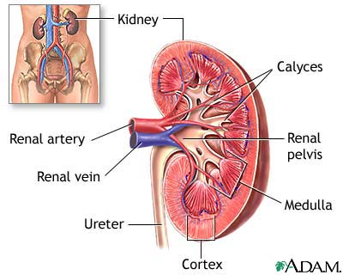

Slide 4
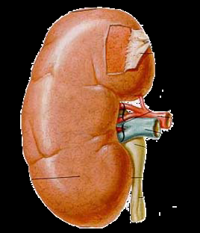
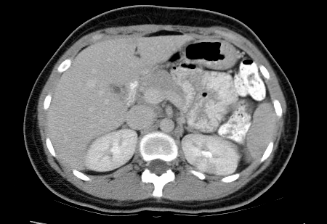
CT Imaging of the Kidney

Slide 5
Clinical applications of CT in renal conditions
These include:
1. Assessment of renal masses and differentiation of solid and cystic lesions.
2. Tumor staging and surgical planning.
3. Renal trauma.
4. Non-invasive diagnosis of renal artery stenosis.
5. Renal colic.

Slide 6

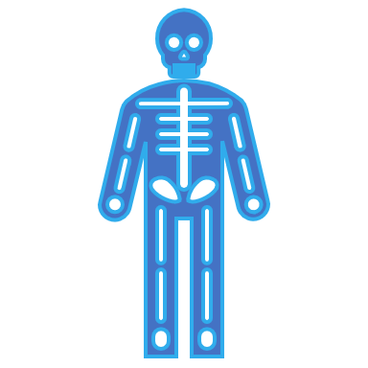
Technique for CT scanning of kidneys
Scan protocol
1- Unenhanced scans through the kidneys to identify calcification and obtain attenuation values of any renal masses
2- Contrast 100 ml intravenously at 3 ml/sec
3- Post contrast 3 mm scans through the kidneys
4- Incremental dynamic scanning, 30–40 second delay (corticomedullary phase).
5- Spiral scanning, 100–180 second delay (nephrographic phase).
6- delayed scans are obtained after 5 minutes (delayed phase).

Slide 7
CT KUB
CT urography: The aim is to illustrate the collecting systems, ureters and bladder with intravenous contrast, albeit in a single acquisition as opposed to the multiple and more dynamic traditional IVU. Visualisation of other structures in the abdomen is also better with CTU than with traditional IVU

Slide 8
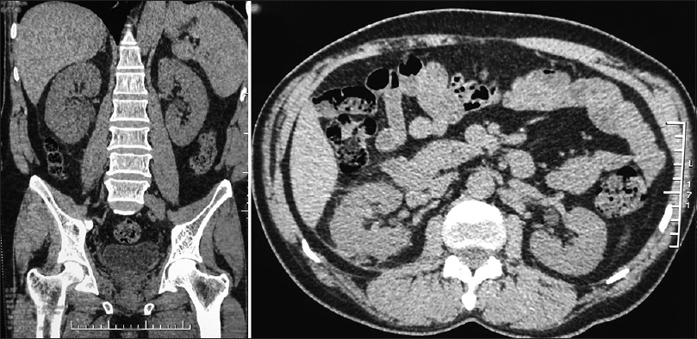
CT KUB

Slide 9
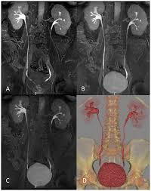
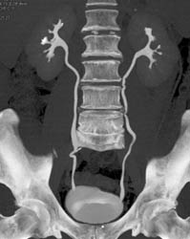
CT UROGRAPHY

Slide 10
The following issues are also important.
1. Precontrast scans for the position of the kidneys are made, to identify calcification and to obtain accurate precontrast attenuation values of masses.
2. Contrast: 100 ml injected at 3 ml/s.
3. Post contrast scans if using incremental dynamic scanning, 5 mm collimation with a 40 second delay.
4. Spiral scanner If this is used, the slice collimation depends on the patient’s ability to hold their breath and the distance to be covered to include both kidneys.
5-Usually a 5 mm slice with a pitch of 1 (table speed 10 mm/sec) and reconstruction every 3 mm is used. A thinner slice of 3 mm and a pitch of 1.5–2 may be advantageous, especially if very small lesions are to be assessed.

Slide 11
.-Scan delay depends on whether:
corticomedullary images (30-40 second delay).
nephrogram images (100–180 second delay) are required.
Small renal lesions are usually better seen on nephrogram images, but renal perfusion is better assessed on corticomedullary images.
Delayed scans at 5 minutes allow assessment of calyceal detail.

Slide 12
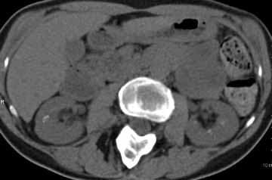
Un enhanced phase

Slide 13
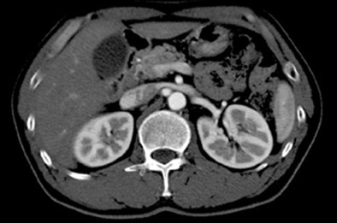
Corticomedullary phase

Slide 14
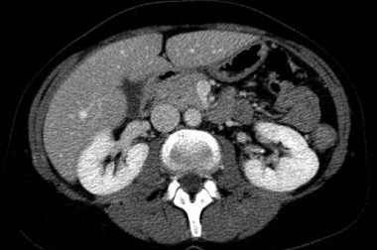
Nephrographic phase

Slide 15
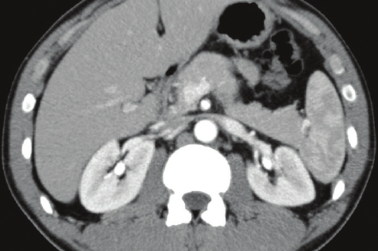
Delayed phase

Slide 16
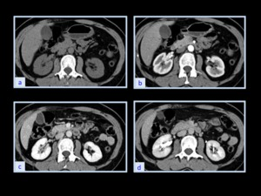

Slide 17
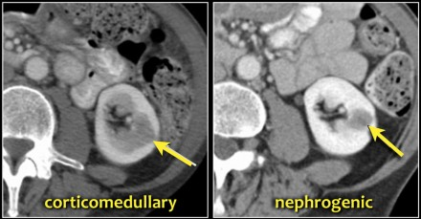

Slide 18
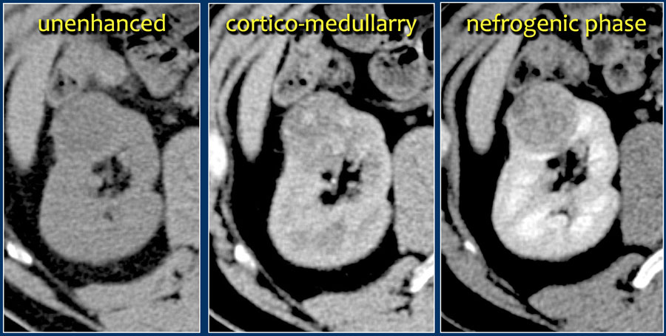

Slide 19
Assessment of renal masses
RENAL CYSTS
The commonest renal mass in an adult is a cyst. The CT characteristics of a benign cyst are the follows:
1-Homogeneous and of water density, CT number 0–20 HU.
2. No enhancement after contrast
3. No detectable wall where cyst projects outside the renal outline
4. Smooth interface with the parenchyma.

Slide 20
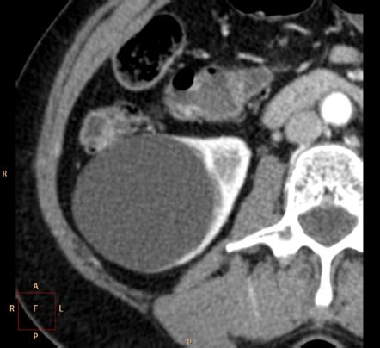
Simple renal cyst
CT number= 15 HU.

Slide 21
-If the lesion exhibits all these features, no further investigation is required.
-Some cysts may be hyperdense and may require further investigation with ultrasound or percutaneous aspiration.
-Cysts which have thick walls or calcification are indeterminate masses.
-Complicated cysts have higher attenuation values than simple cysts( usually above 40 HU)

Slide 22
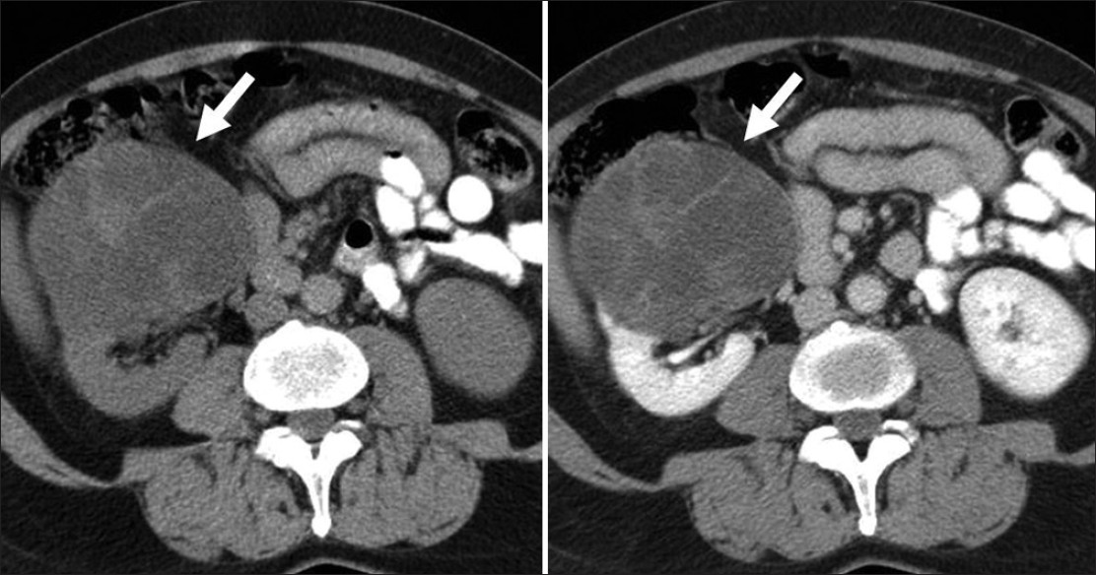
Complicated renal cyst
CT number = 45 HU.

Slide 23
RENAL TUMORS
The characteristics of renal cell carcinoma include the following:
1. A heterogeneous mass with attenuation less than normal kidney.
2. Enhancement following contrast, but normally less than the surrounding renal tissue on delayed scans. On early arterial phase scans, vascular staining may be seen.
3. Irregular interface with renal parenchyma.
4. If a wall is present, it is thick and irregular

Slide 24
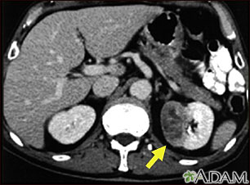
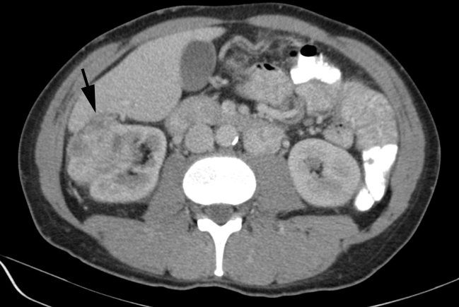
Renal cell carcinoma

Slide 25
Renal trauma
-Spiral scanning is ideally suited for patients with abdominal trauma, as it allows the rapid acquisition of data in critically ill patients at optimal vascular opacification.
-In general, in abdominal scanning following trauma, precontrast scans are not usually performed.
-A delay of 45–60 seconds between injection and the commencement of scanning will allow assessment of parenchymal perfusion defects in the kidneys and the diagnosis of arterial extravasation.
-Delayed scans at 10 minutes will be required to assess the integrity of the calyceal system if the patient’s condition permits to detect any contrast extravasation.

Slide 26
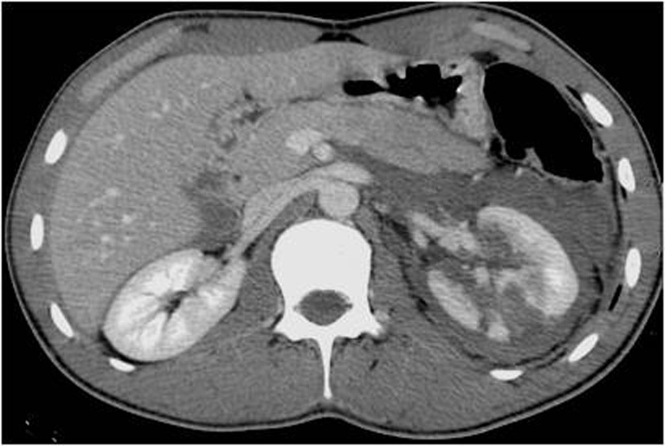
Renal trauma

Slide 27
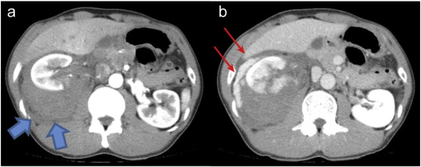
Delayed scans

Slide 28

Thank you

